Slide 1

Project 2 : Ames Housing Data and Kaggle Challenge
Kelvin Lim, Kelvin Kong, Pei Qing

Slide 2
Table of Contents
Problem Statement
Data Cleaning
Feature Engineering
Exploratory Data Analysis/Visualization
Modelling
Generate Final Prediction
Conclusion

Slide 3
1. Problem Statement
Predict the price of a house at sale with the use of a regression model.

Slide 4
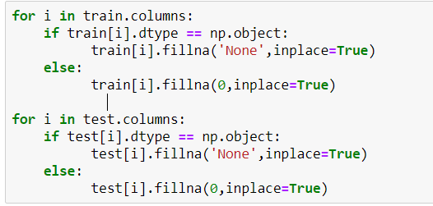
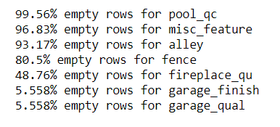
2. Data Cleaning
Handling Null Values
Ordinal (‘None’)
Numerical (‘Median’)
Drop columns with many NULL values

Slide 5
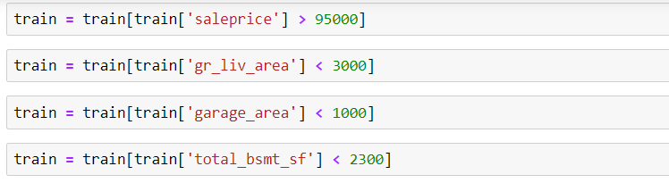
2. Data Cleaning
Dropping of outliers in data

Slide 6

3. Feature Engineering
Encoding of Ordinal Columns with Find-and-Replace method
One-hot-encode Nominal columns with pandas get_dummies()

Slide 7
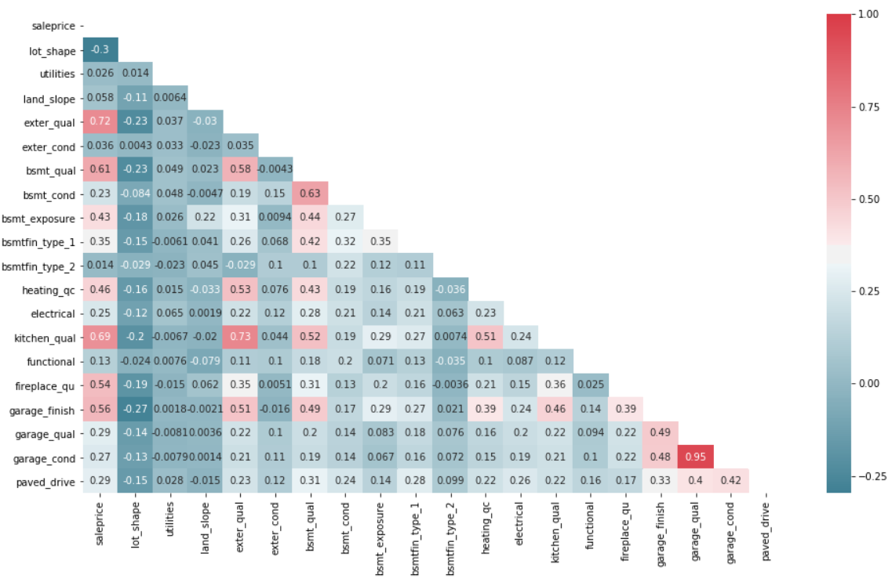
3. Feature Engineering
Drop independent features that are highly correlated with each other

Slide 8
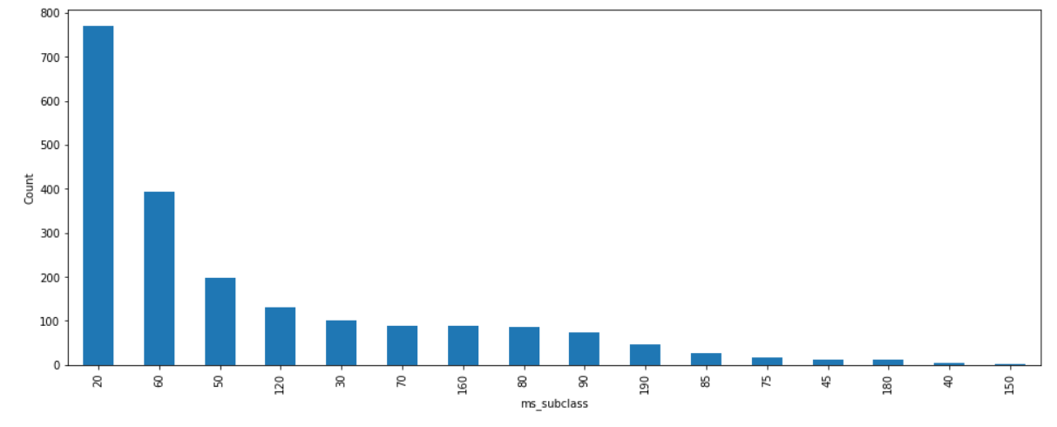
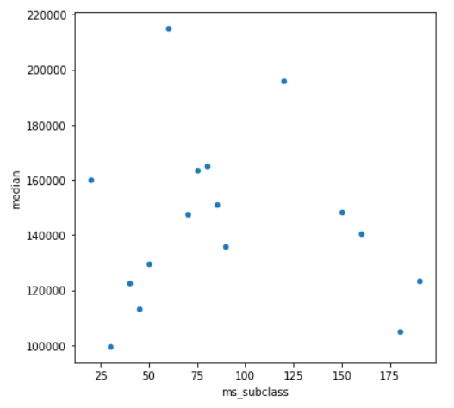
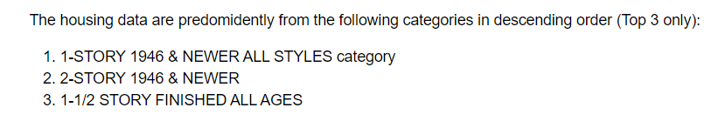
4. Exploratory Data Analysis

Slide 9
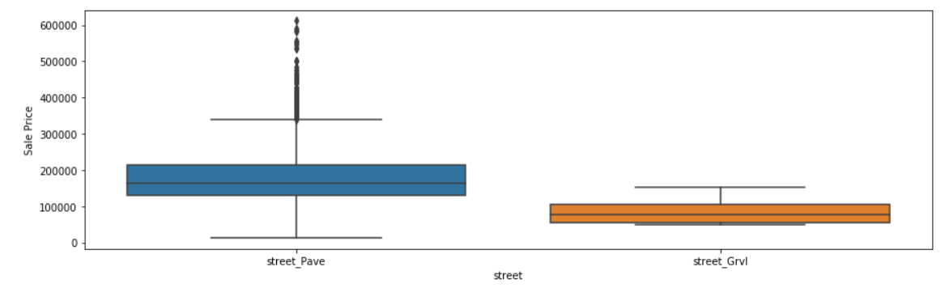
4. EDA on Categorical Columns
Correlation of categorical columns against Sale Price
E.g. Houses with Pavement and Houses with Gravel

Slide 10
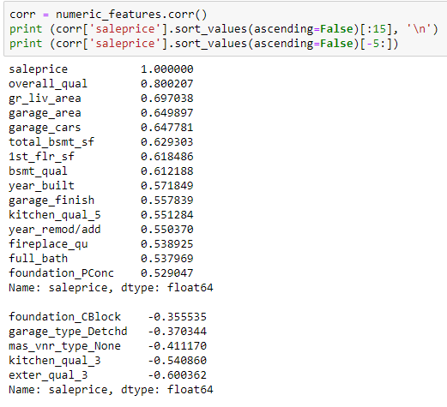
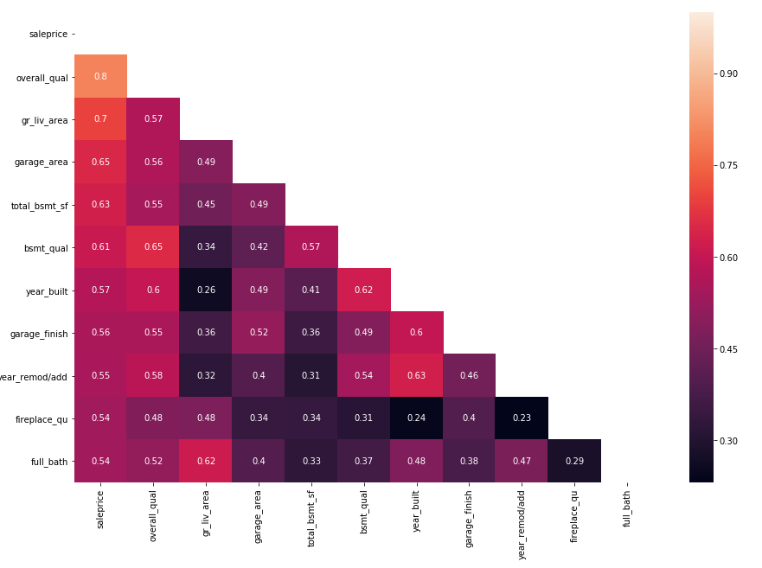
4. Exploratory Data Analysis

Slide 11
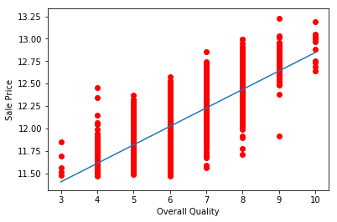
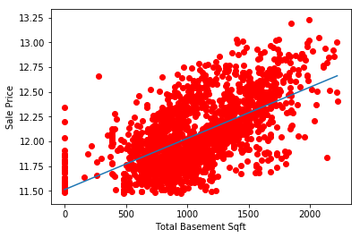
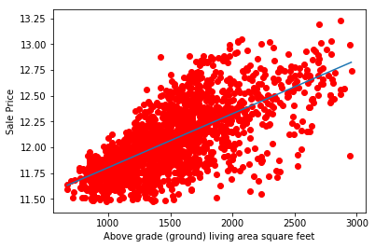
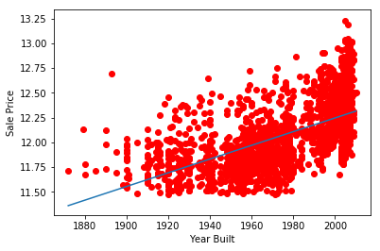
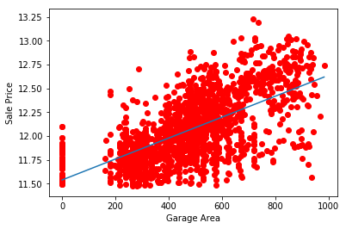
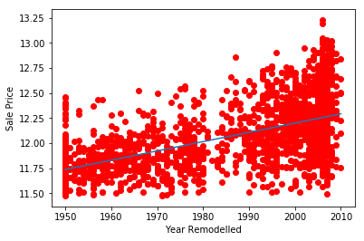
4. EDA Visualization (Correlation Scatter Plot)

Slide 12
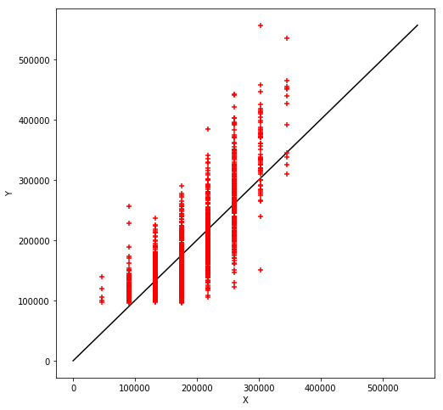
5. Modelling
41853.445556205515
MLR with 1 predictor feature
Mean Squared Error: 41853.45
R2 Score: 0.6184

Slide 13
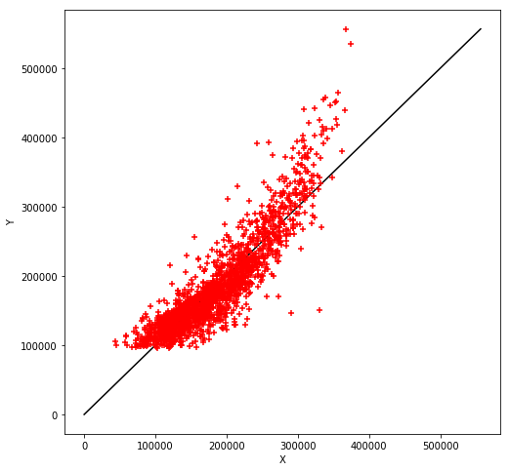
5. Modelling
41853.445556205515
MLR with 5 predictor features
Mean Squared Error: 29921.59
R2 Score: 0.8050

Slide 14
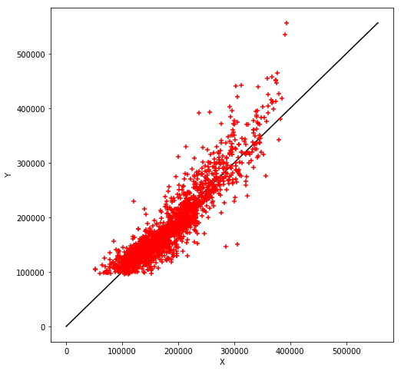
5. Modelling
41853.445556205515
MLR with 10 predictor features
Mean Squared Error: 26906.07
R2 Score: 0.8423

Slide 15
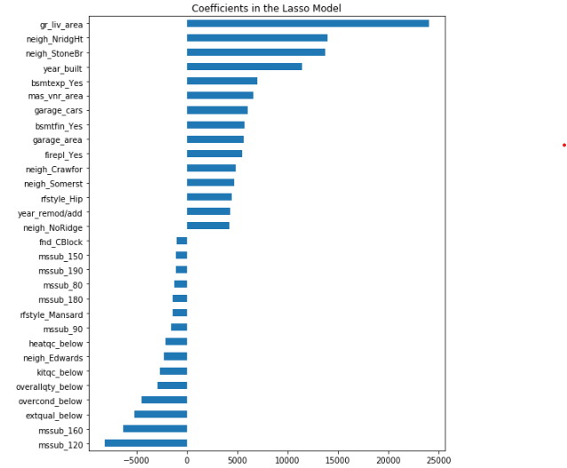
5. Lasso Regression Model
Top 20 and bottom 5 features selected for Lasso Regression Model.
Before Feature Selection R2 Score: 0.8607
After Feature Selection R2 Score:
0.8431

Slide 16
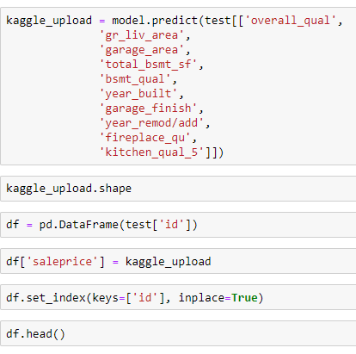
6. Generate Final Prediction
Generate DataFrame for Kaggle Submission
Kaggle Scores:
MLR 10 features – 33415
Ridge 25 features – 33052
Lasso 25 features - 35154

Slide 17
7. Conclusion
Business Recommendations:
Ground Living Area
Location within City
Year Built

